Slide 1
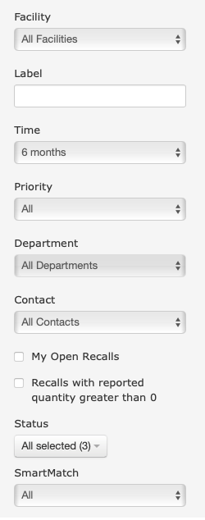
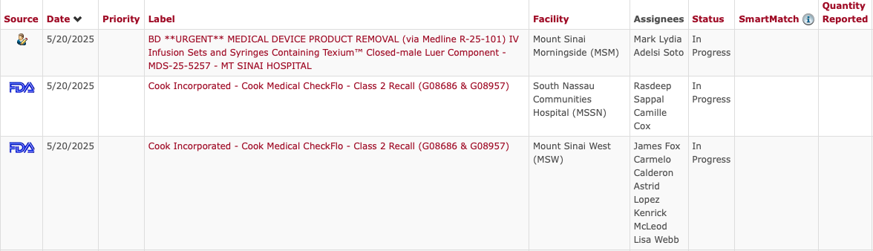
Open Recall Progress Tracker
Recall Ticker Widget at Page Bottom

